Slide 1
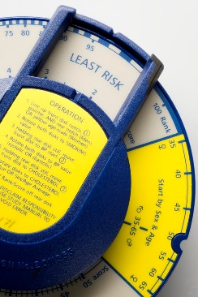
The Dundee
Coronary Risk-Disk
A logistic regression instrument
Simon A.M. van der Salm
International Meeting
Historical Calculating Instruments
USA, September 12 - 13, 2020

Slide 2
The Dundee Coronary Risk-Disk:
1. What is it?
2. How does it work?
3. Alternatives?
4. Calculation history
5. What is (logistic) regression?
6. Article with the math
7. Conclusions

Slide 3
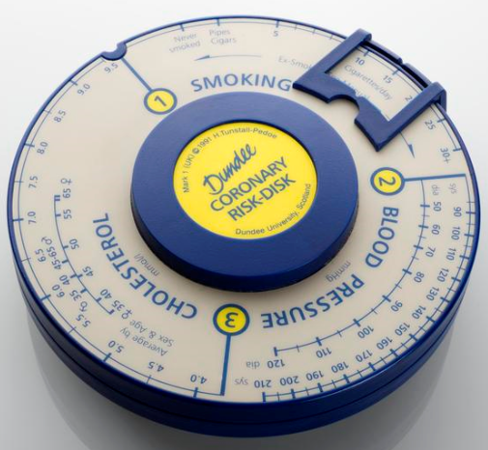
1. A device to determine the relative risk of coronary heart problems in patients.
Notes:
5 year’s risk Relative to the patient’s age group and sex
Diameter 12 cm

Slide 4
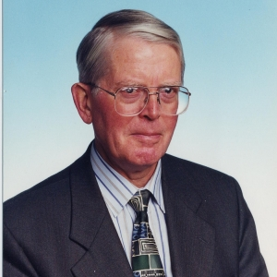
Designer (1990-1991)
Emeritus Professor
Hugh Tunstall-Pedoe
Dundee University, Scotland

Slide 5
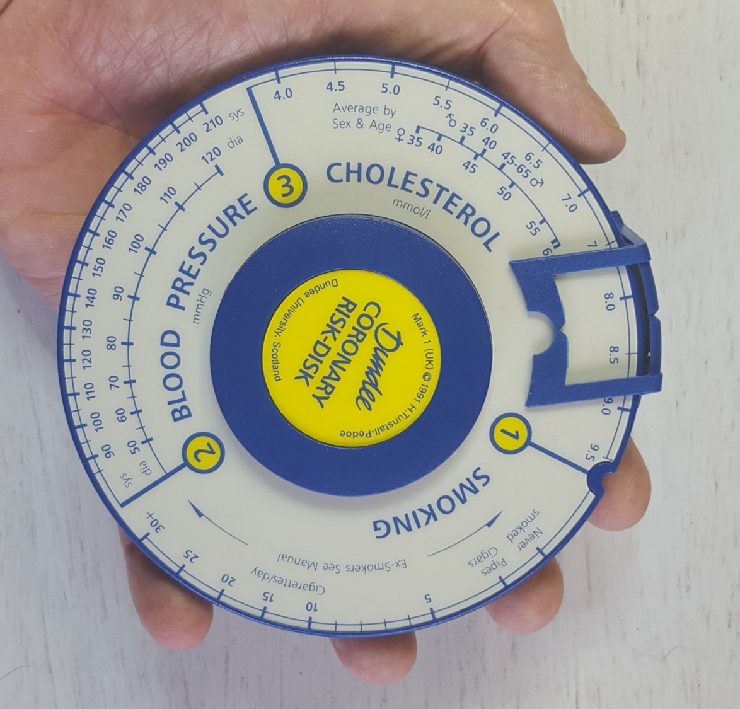
Hand-held
Circa 12 cm

Slide 6
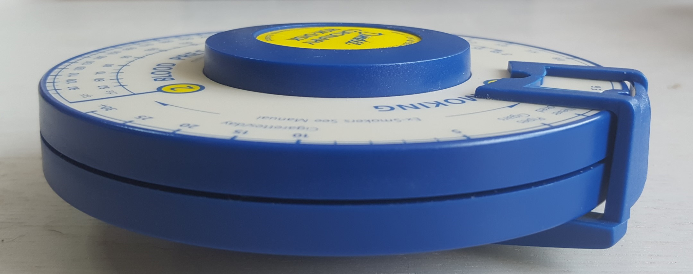
Actually two disks
Circa 3.5 cm

Slide 7
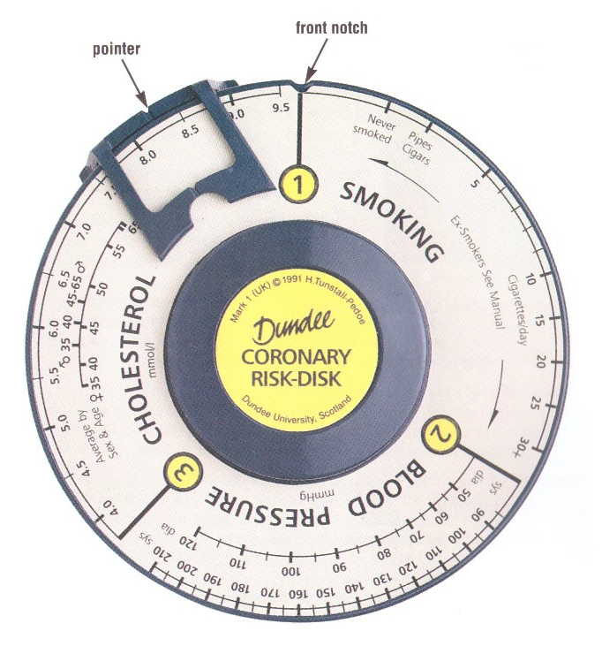
Front Disk
3 main variables

Slide 8
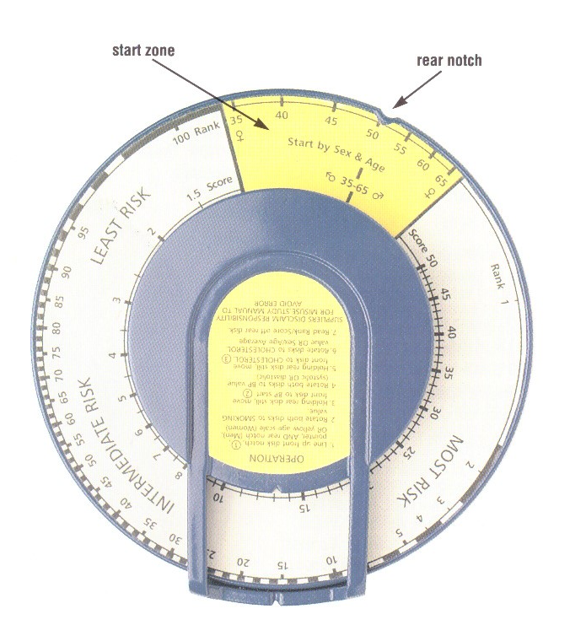
Rear Disk
1 semi variable
Constant 50 for men
Offset for women
Dundee Rank DR
Dundee Score
DS

Slide 9
2. How does the combination of two disks work?
An Example
Male:
1: 10 Cigarettes per day
2: Systolic blood pressure 140 mmHg
3: Cholesterol 6.5 mmol/L
Notes:
1. A general example for men

Slide 10
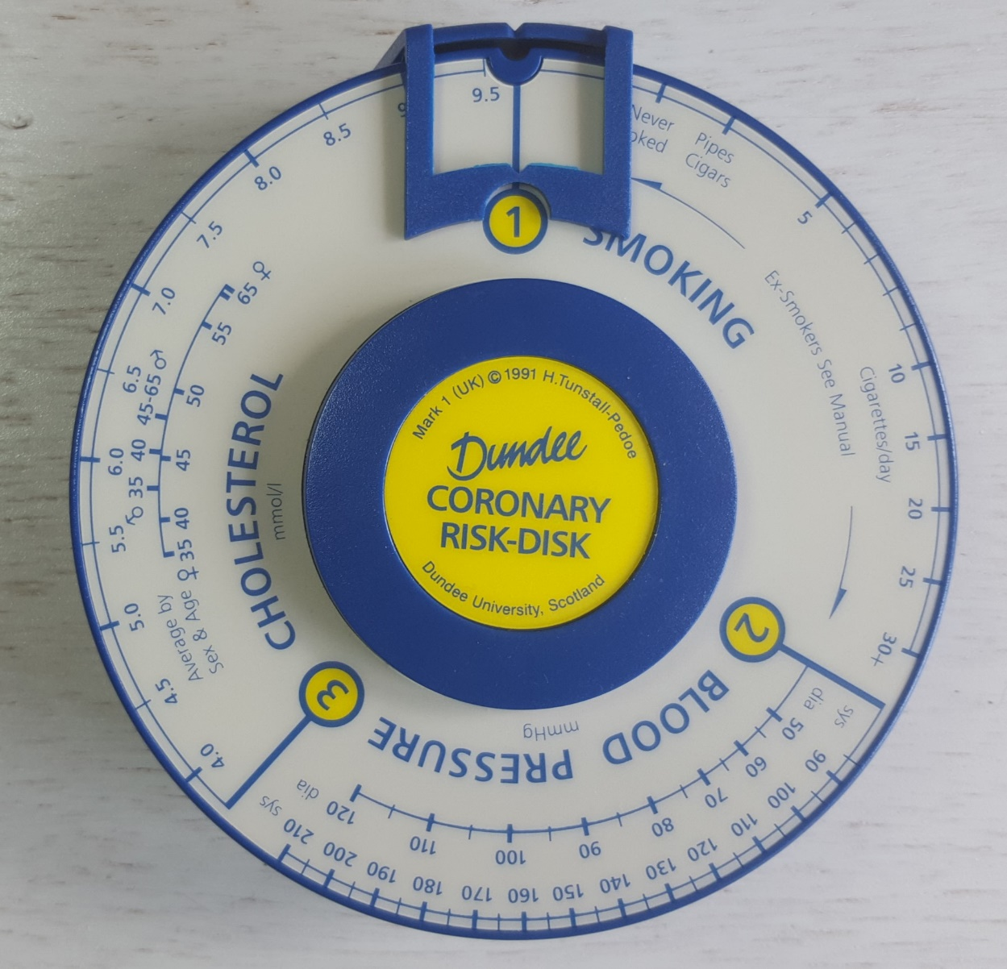
Initial setting
Coincident notches
No. 1
in recess

Slide 11
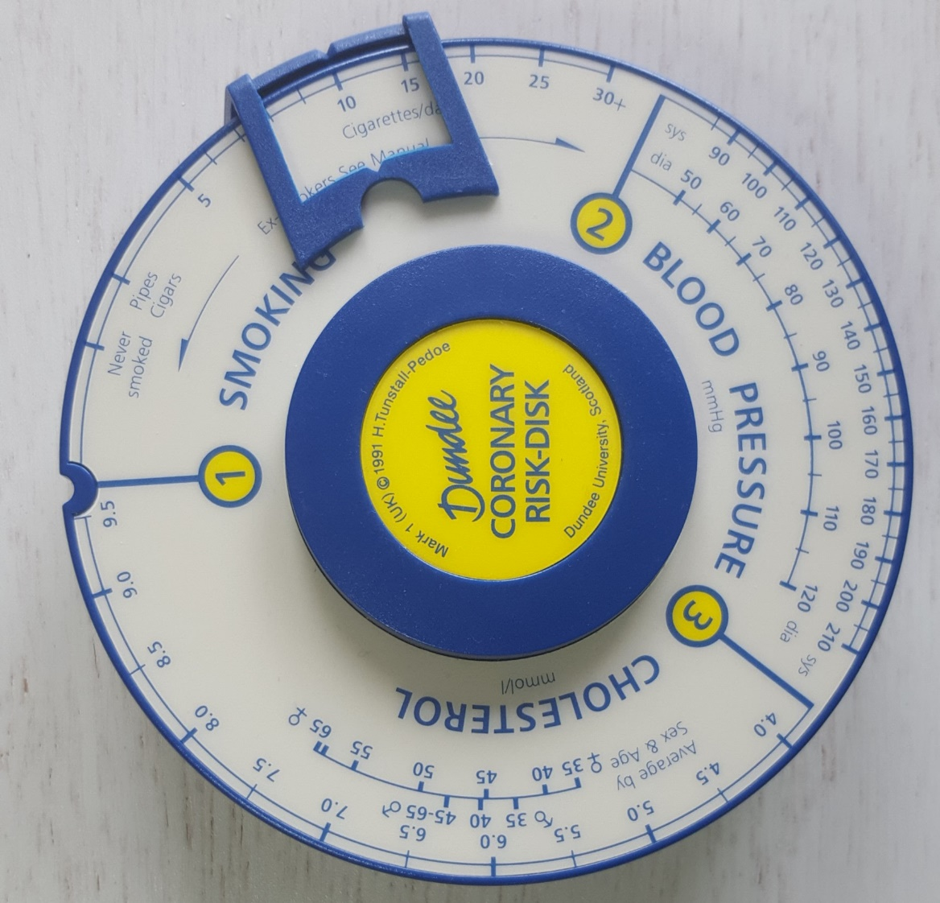
Turn the pointer to the right to 10 cigarettes per day

Slide 12
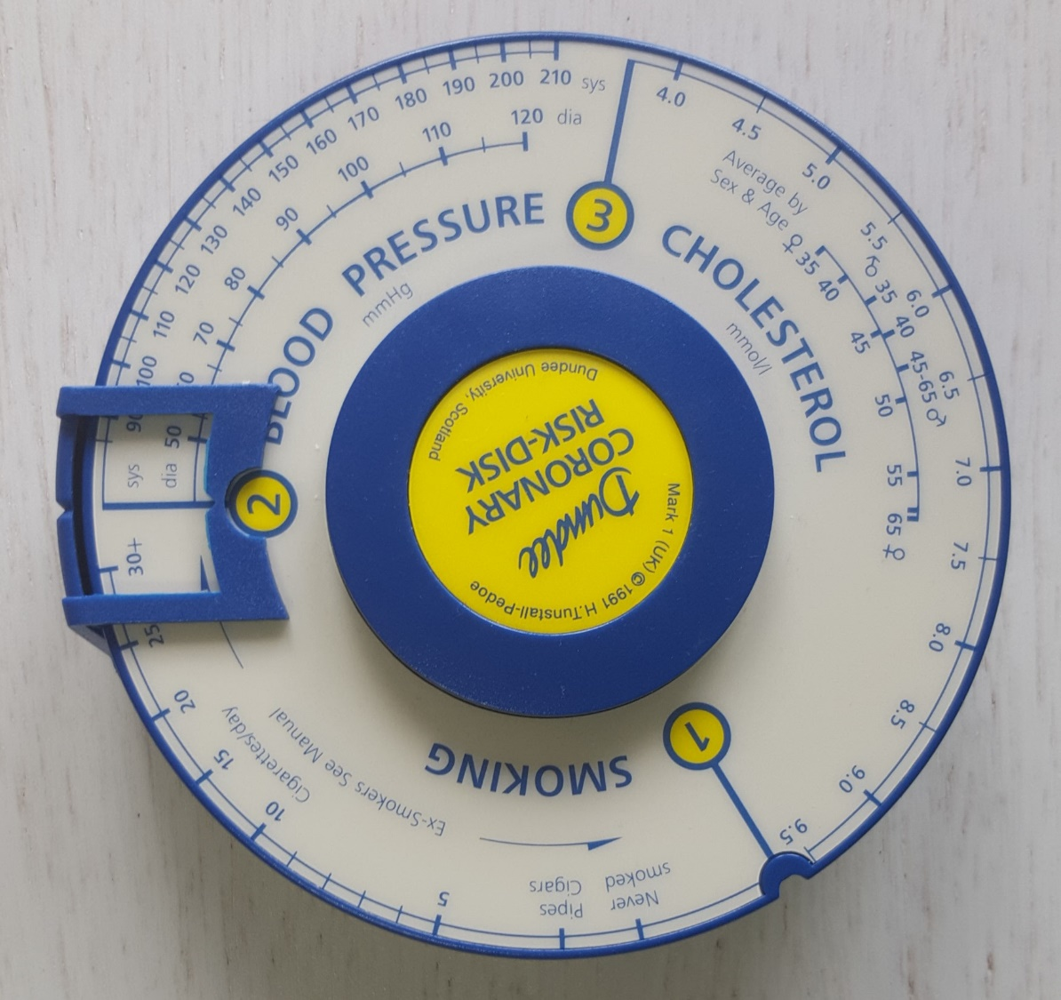
Turn the front disk to the left till No. 2 in the recess

Slide 13
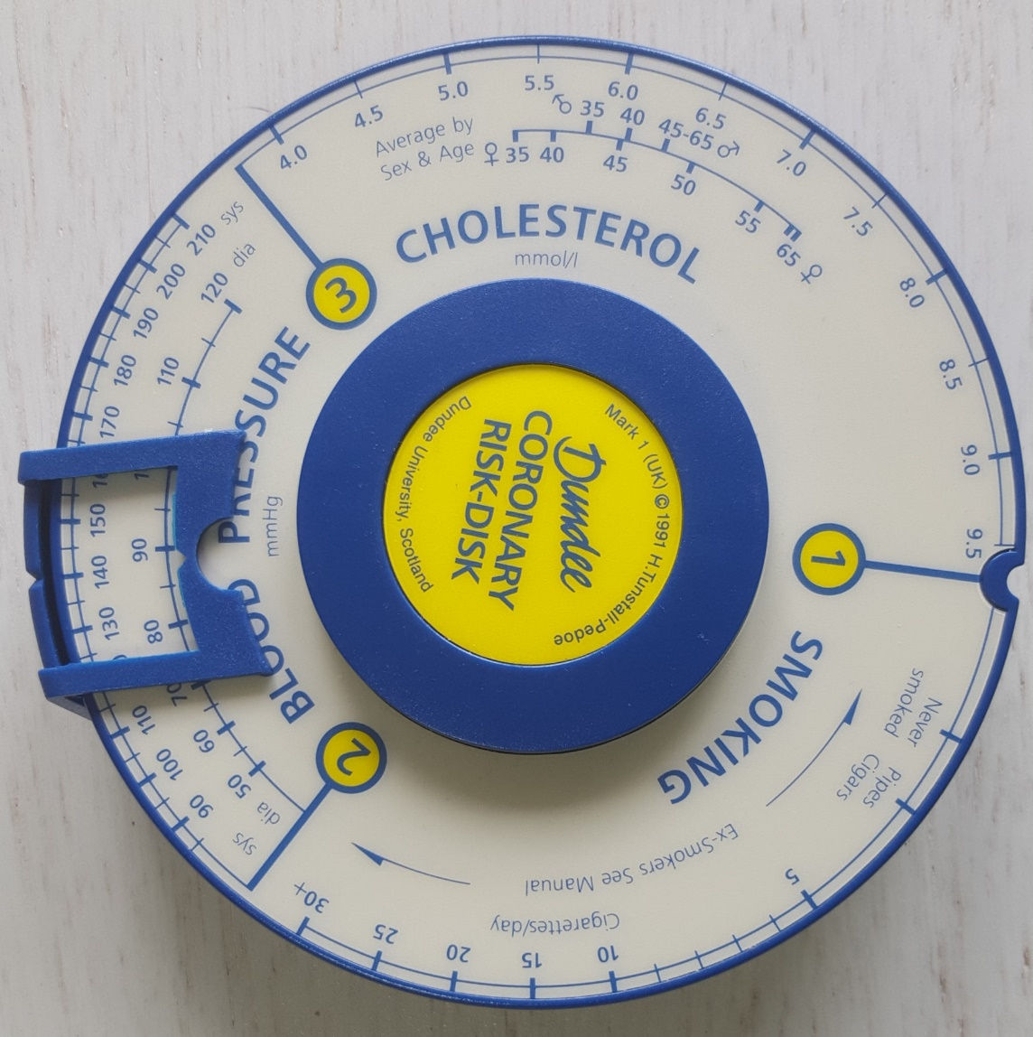
Turn the pointer to the right to 140 mmHg

Slide 14
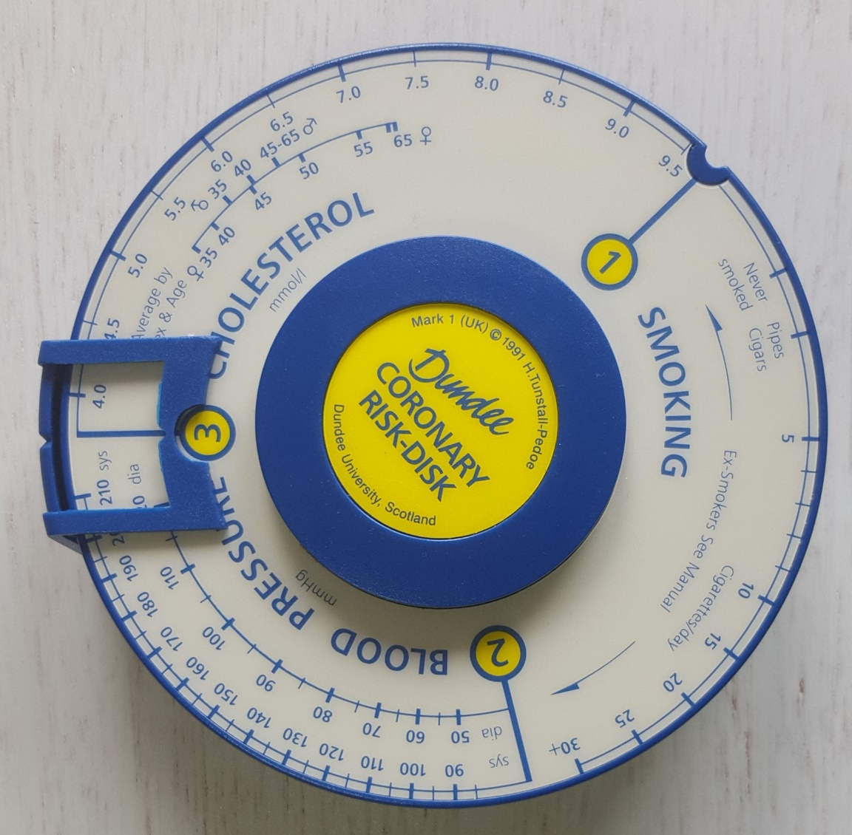
Turn the front disk to the left till No. 3 in the recess

Slide 15
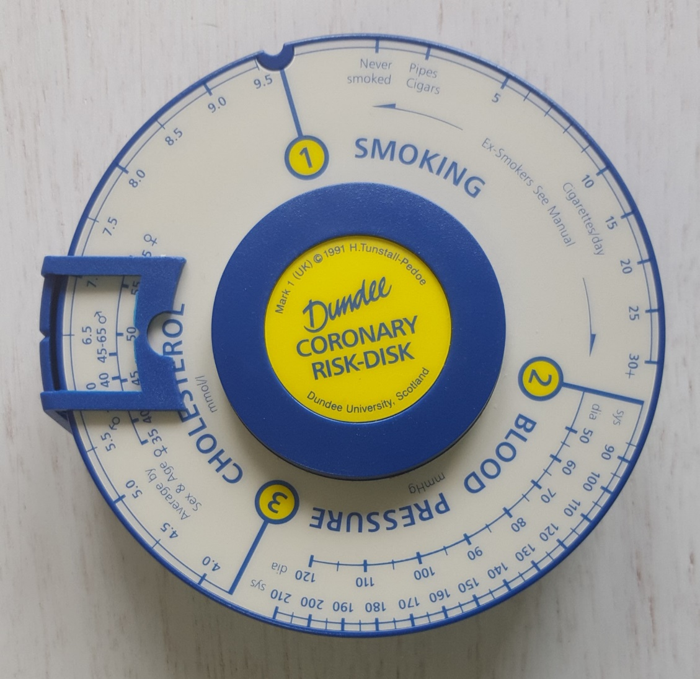
Turn the pointer to the right to 6.5 mmol/L

Slide 16
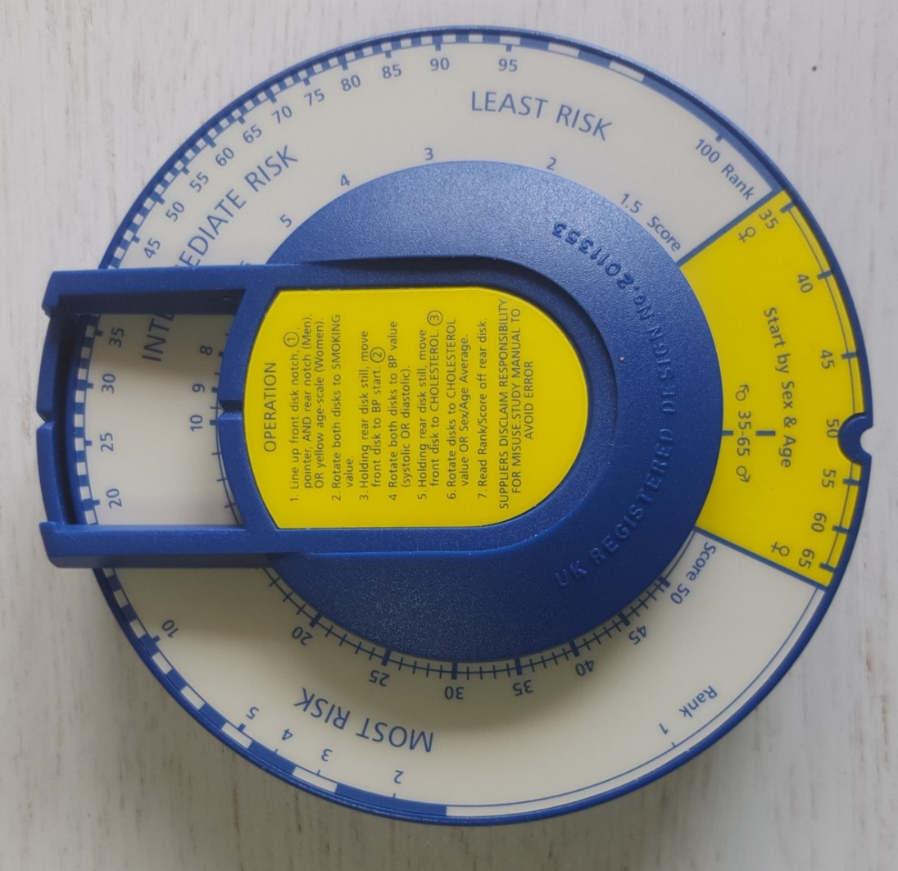
Read off from rear disk:
DS ≈ 9.5 and DR ≈ 27: intermediate risk

Slide 17
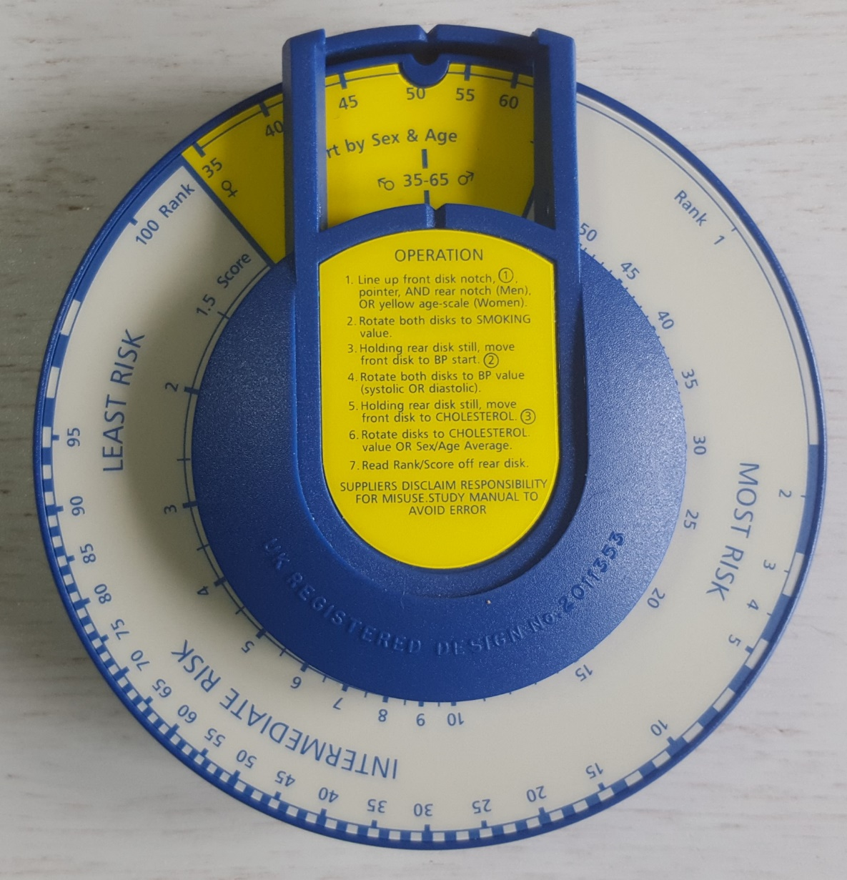
Initial setting seen from the rear

Slide 18
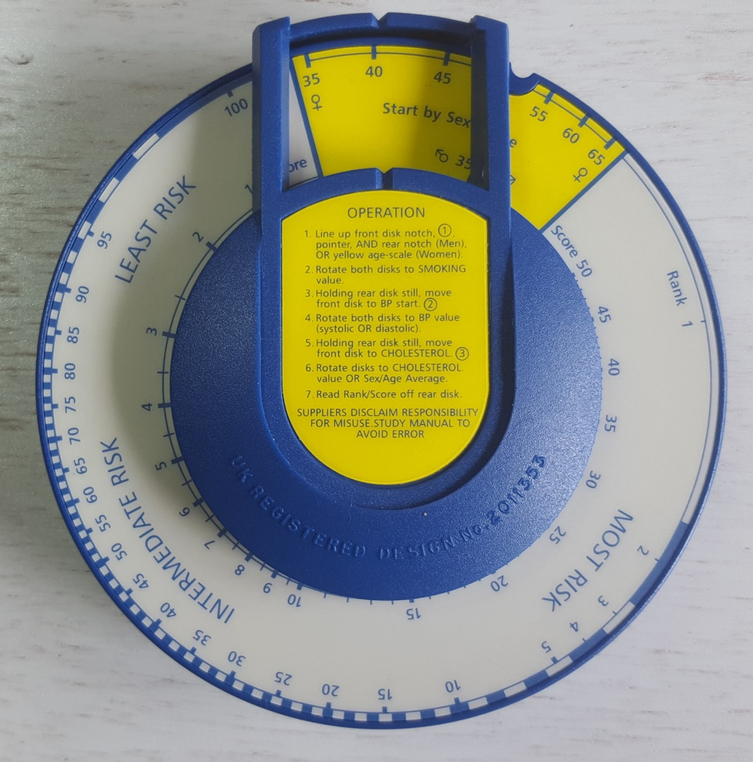
Offset for females:
turn only the rear disk
Age setting
40 years
Notes:
1. After the offset for women has been set, the remaining actions are identical with those for men.

Slide 19
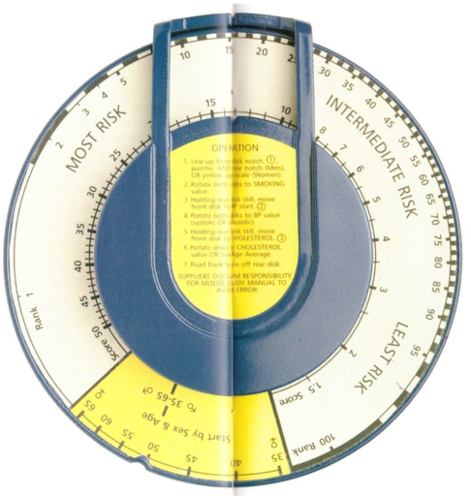
Two results
DS DR

Slide 20
Log-normal relation DS - DR
Notes:
1. See for math details the article

Slide 21
DR = percentile
Waiting for a ‘coronary’, as in a queue at the bus stop
DR = 100: least at risk
DR = 1: most at risk
Notes:
1. Relative risk as a percentile: as a place in a waiting queue at a bus stop

Slide 22
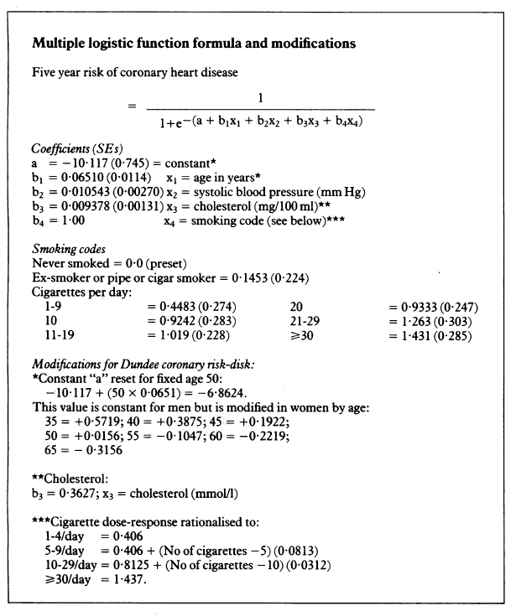
3. Typical logistic
regression formula
Notes:
Linear sum which is typical for OLS
But here in the exponent: typical for logistic regression

Slide 23
Alternatives: nomograms
No automatic adding

Slide 24
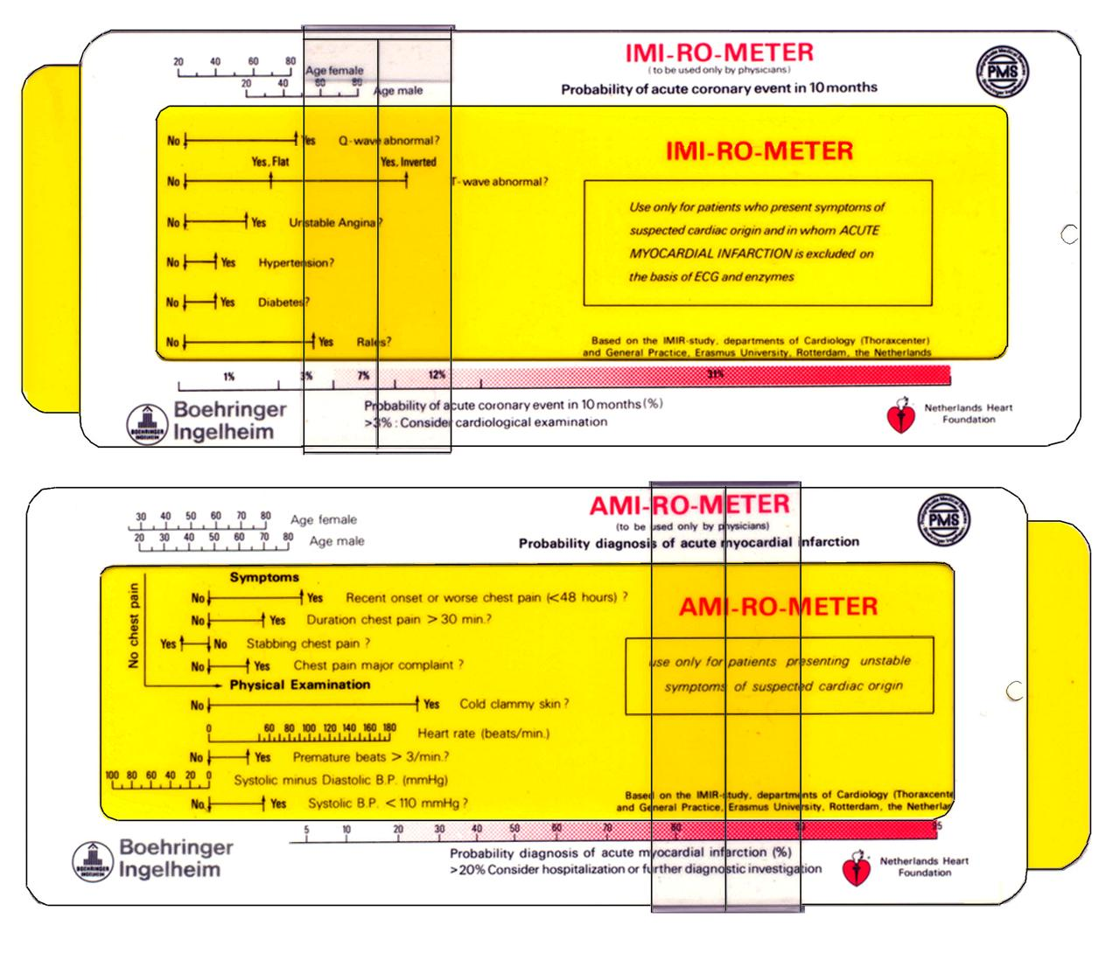
Alternatives made by ALRO
Automatic adding

Slide 25
Alternatives :
EU prostate cancer risk-disk
A digital software tool, but with analogue output
Notes:
1. Although a digital version the outpunt is more understandable in analogue form

Slide 26
Alternatives:
Framingham risk charts
Notes:
1. Same idea as with nomograms: collect values and add them. Look in a parallel scale the probability.

Slide 27
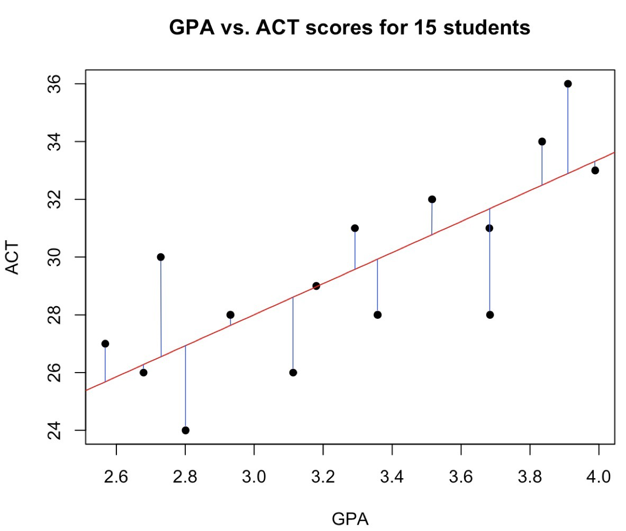
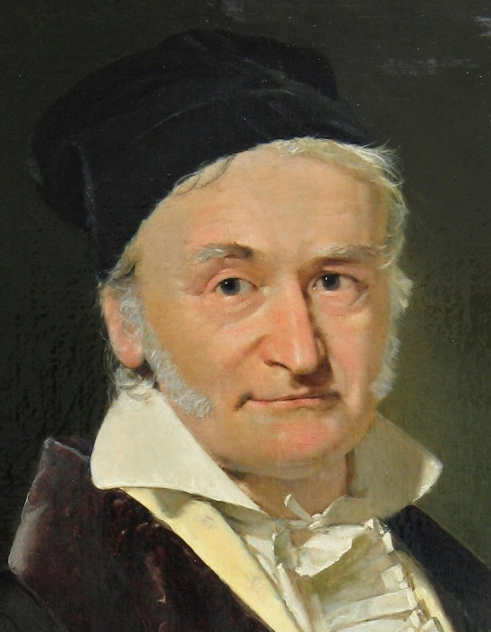
4. History of regression calculation
Carl Friedrich Gauss (ca. 1800): OLS
Notes:
Vertical distances squared and added. OLS = sum of squares minimized.
OLS = Ordinary Least Squares.

Slide 28
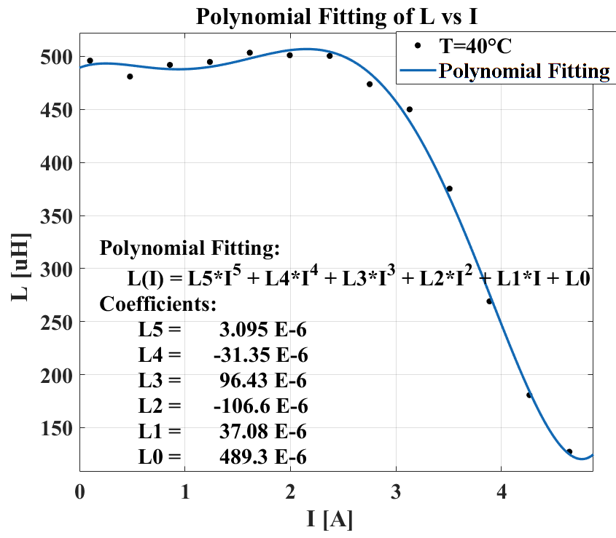
Polynomial via least squares
With a computer and matrix algebra: plain sailing
Notes:
Much more calculation work, but with a computer very simple to do.
Befor the computer age a day-long calculation, if possible

Slide 29
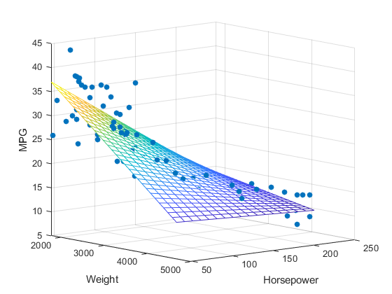
Multiple linear regression
With a computer and matrix algebra: plain sailing
‘Only’ two independent variables
Notes:
The same principle: OLS
Matlab: easy to manipulate

Slide 30
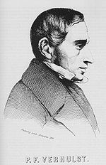
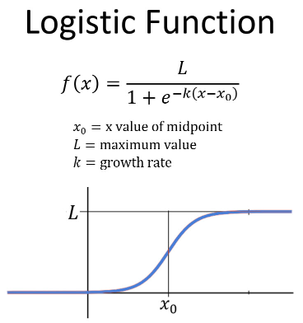
Pierre François Verhulst
(1804 – 1849)
Notes:
Belgium Mathematician/pupil of Quételet.
Verhulst was the first to use logistic function.
Formule here is the standard formula
See artlce in MIR 81 KRING

Slide 31
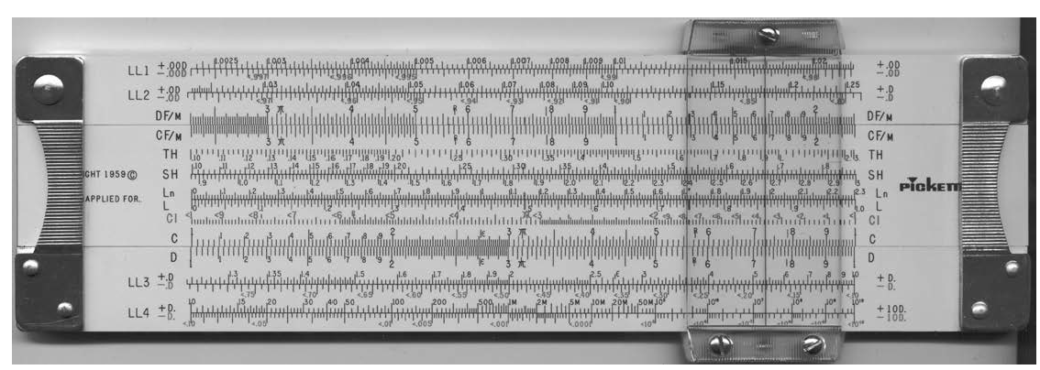
Logistic function
Application of the slide rule Th-scale
Notes:
The Verhulst logistic function can be calculated with Th-scale on slide rule.
Not often mentioned
See article in MIR 81 KRING
When I was writing about Verhulst Andries de Man told me about the risk disk.

Slide 32
An amazingly accurate logistic forecast
Rediscovered in the 1920’s by American demographers
Notes:
The accuracy was discovered in the 1920’s, long after his death.
Nowadays such an accurate result will be considered as potential fraud.

Slide 33
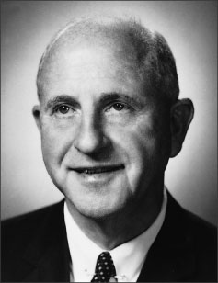
1944: Joseph Berkson
Logit-function
The log odds-formula
Simplification of calculations
Notes:
Year 2000 Nobel Prize for McFadden for logistic regression applications in the socio-economic sciences.
Here you must think in terms of odds (wel-known in the UK bettings) instead of probability
3. The parameters must be estimated by Maximum Likelyhood instad of OLS

Slide 34
2000: Daniel McFadden
Nobel Prize
"for his development of theory and methods for analyzing discrete choice”
Notes:
Year 2000 Nobel Prize for McFadden for logistic regression applications in the socio-economic sciences.
Here you must think in terms of odds (wel-known in the UK bettings) instead of probability

Slide 35
5. What is Logistic Regression?
A typical example
My own students often ask:
“How many hours do I have to study to pass the exam?”
Notes:
1. Discrete choice: logistic regression

Slide 36
Amazingly, that question can be answered with fairly good accuracy
Maximum Likelyhood
Verhulst curve
with Generalised Reduced Gradient
Notes:
20 data points 0 or 1.
Discrete character of the dependent variable
We look for a S-curve that fits the data best
Maximum likelyhood estimation gives the curve
GRG: generalized reduced gradient algorithm
The more data, the better is the learning: machine learning is possible

Slide 37
Of course the answer is the prediction of a probability
so, I as their statistics lecturer am always right
Naturally

Slide 38
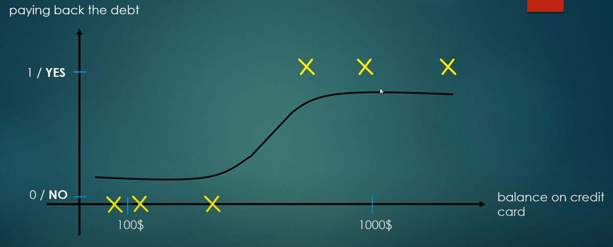
Example: credit cards

Slide 39
Machine learning
Here most simple situation:
Binary classification

Slide 40
Example: ECG machine learning
A noisy signal
By logistic regression the monitor learns when to trigger an alarm

Slide 41
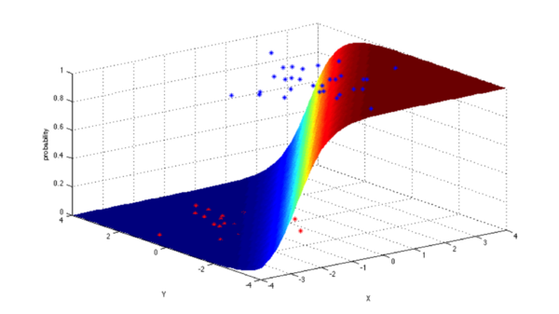
Example: logistic regression
with ‘only’ 2 variables
Notes:
With 3 or more variables we can’t make a picture

Slide 42
6. From the logit
to the
Dundee Coronary Risk-Disk it is a small step in math, but a giant leap in
calculation technics.
Please, see for details the article
Notes:
There is a lot to tell about the mathematics
The math can be studied from the article

Slide 43
7. Conclusions
The Dundee Risk-Disk seems to me to be a very original implementation of logistic regression.
Considering the difficulties of the math process that lies hidden behind the design, it is amazing such a complex process could be embedded in such an easy to use tool.
It really is a wonderful analogue instrument at the beginning of the digital era.

